Slide 1


Spotify Through Covid
UTSA Data Analytics Bootcamp – May 2022
Aaron Eger, Elizabeth Loy, Kayla Kidwell, Ricky Martinez

Slide 2




Hypothesis
Covid-19 has had a noticeable affect on Spotify’s revenue and premium subscription user base.

Slide 3
Why Spotify?
What is Spotify’s revenue trend? Has it changed during the pandemic?
Has the number of premium subscriptions been affected? Increased or decreased?
Has the overall number of users been affected? Increased or decreased?
Has the individual hours listened changed through since the beginning of the Covid pandemic?
What might the answers to these questions mean for Spotify in the near future?
Most of our group uses Spotify on a regular basis. Our usage has increased, and I even got a premium membership during this time. Is seemed poignant to research the significance Covid-19 has had regarding this music streaming platform.
We wanted to see if our experiences could be a representation of the user-base as a whole.

Slide 4
API Issues and Shareholder Letters
A .csv file was created which contained quarterly data on premium and non-premium subscriber counts, total revenue, and difference between quarters from the beginning of 2018 to the end of 2022. This data represents two solid years prior to the pandemic, and two solid years in. This data was used by all members of the group.
Nearing the end of graphing the data I realized the sample size is probably too small to draw a meaningful conclusion, and I would have pulled several more years of pre-Covid data.
GitHub URL: https://github.com/abesprgrss/Project-1.git
We initially had the plan to gather our information using Spotify’s API, but that plan proved to be outside of this scope as they require a pre-built app and software development experience.
Therefore, we drew in our questions and relied upon shareholder statements to retrieve the data we were looking for.

Slide 5
Spotify Revenue Pre-Covid to Current

Slide 6
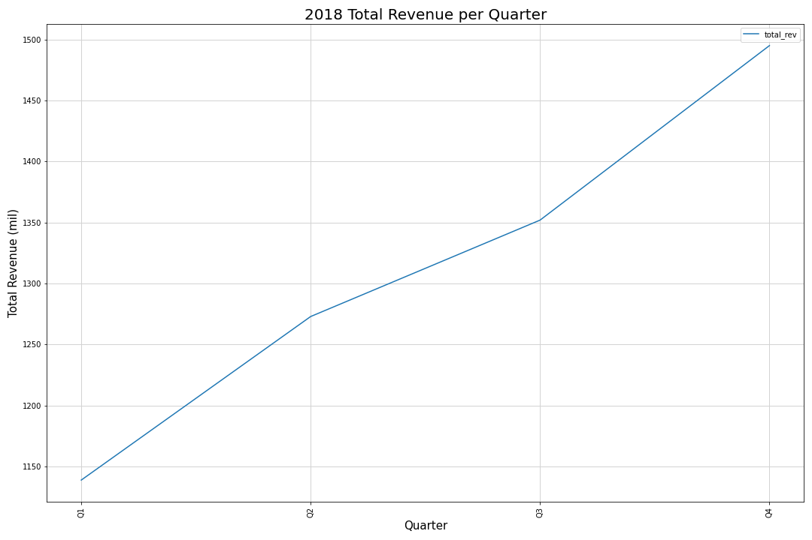
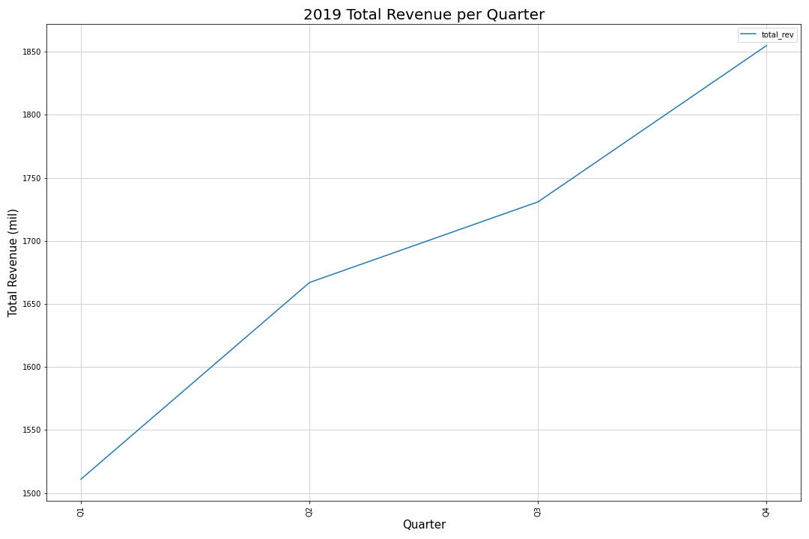
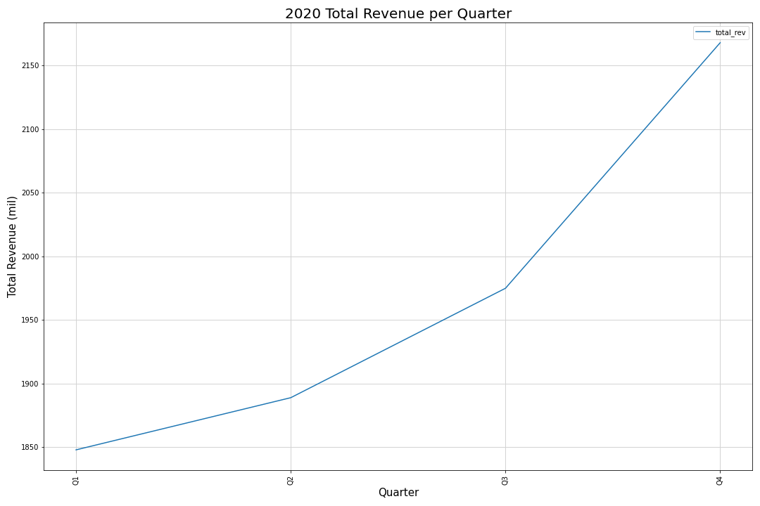
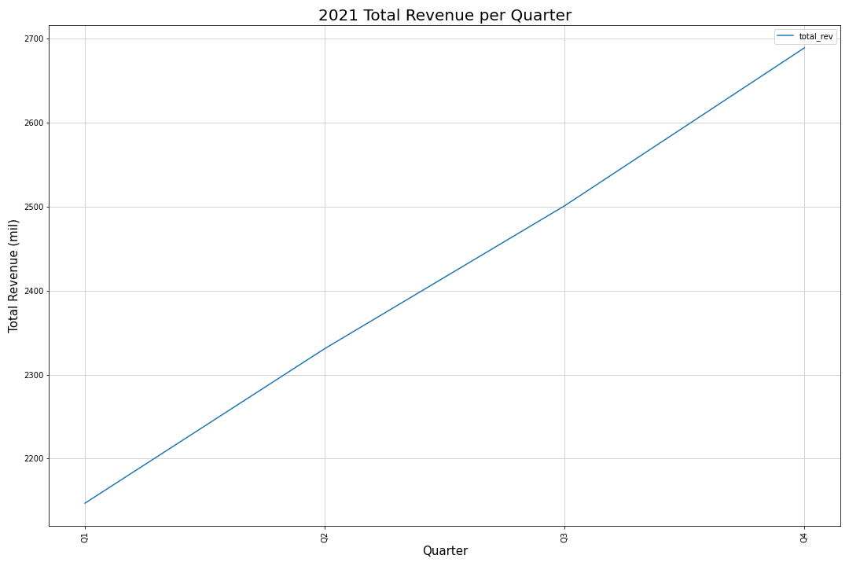

Slide 7
Revenue by Quarter Per Year
2018 This graph shows the breakdown of the revenue by quarter as we saw in the last graph 2018 started off with a dip in revenue but slowly started making up by the 2nd quarter and a continual increase resulting in a total increase in revenue of 356M.
2019 This graph shows the breakdown of the revenue by quarter as we saw in the last graph 2019 started off with the same momentum as 2018 resulting in a revenue increase of 156M between the 1st and 2nd quarter. The momentum slowed down with an increase of 64M between the 2nd and 3rd quarter. The total increase in revenue from 2018-2019 was 344M.
2020 In this graph what is not noticeable in this graph is between 4th quarter of 2019 and the 1st quarter of 2020 there was a slight loss in revenue of 7M. However, by the 2nd quarter the revenue doubled between each quarter showing a total increase in revenue for the year 2020 of 320M.
2021 Just like 2020 and 2018 there was a dip in revenue between the end of 2020's 4th quarter and the end of the 1st quarter for 2021, there was another dip in revenue of 21M. After that 2021 goes on to prove Spotify's most lucrative year to date with a quick and steady increase in revenue, finishing with the highest revenue increase to-date of 542M for the year.

Slide 8
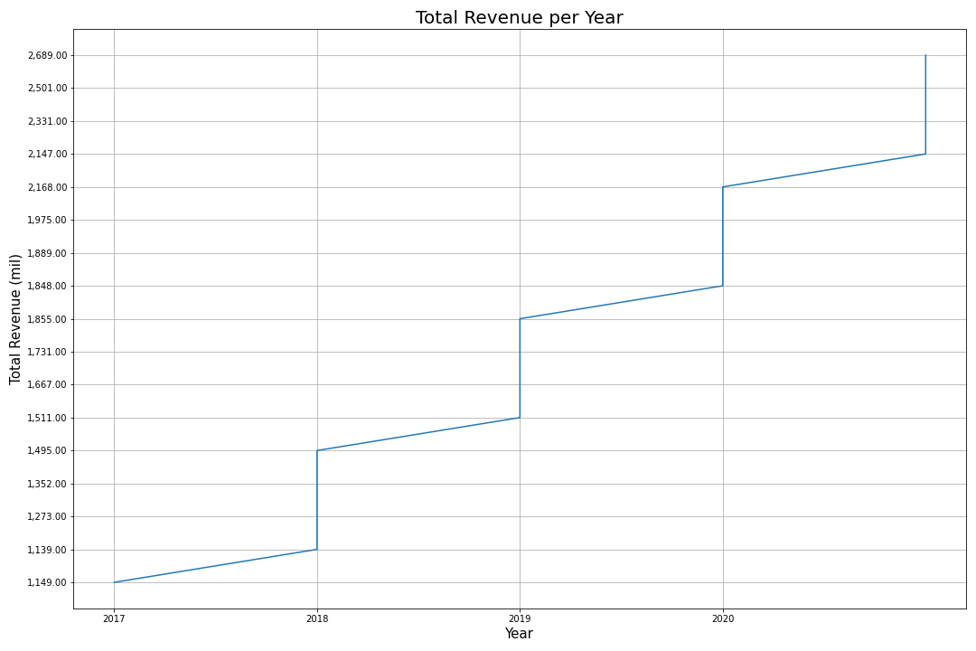

Slide 9
Total Revenue Per Year
The previous slide shows the steady increase in revenue per year.
This yearly increase appears unchanged even in the Covid years.

Slide 10
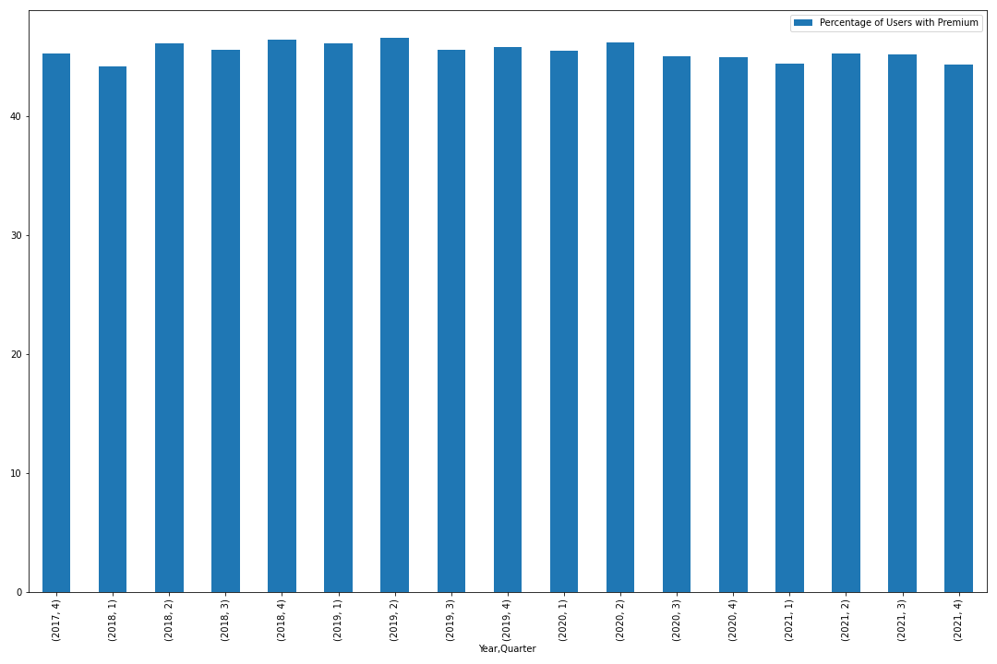

Slide 11
Percentage of Premium Users
The previous graph shows the percentage of premium users in relation to total users.
As you can see, the quarterly numbers of premium users remains around 45% of total users.
Just based on this data, the change in premium usage does not show a decrease or increase, meaning Covid may not have had a significant impact on these numbers.

Slide 12
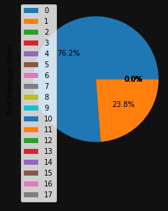
Premium Users vs Non-Premium Users
This pie chart is another representation of the percentage of premium subscribers in relation to non-premium users.

Slide 13
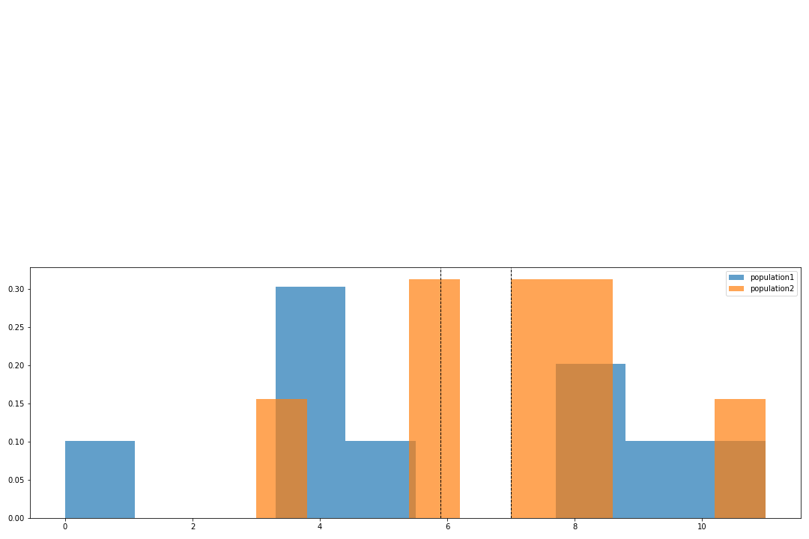
Histogram
This histogram shows the relationship between the average changes in pre- and post-Covid premium memberships. At a glance, the difference does not appear obvious.

Slide 14
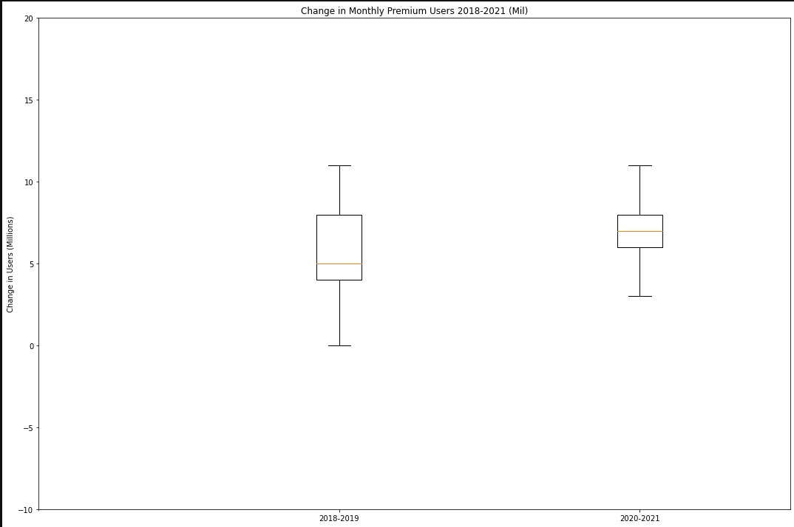
This boxplot shows the same relationship between the two sets of years.
After running the independent t-test, the p-value is 0.43, well above .05, meaning this is statistically insignificant.

Slide 15
In Conclusion
The data appears to show a null hypothesis, and this is proven with a p-value of 0.43.
If the data range covered a larger span of time, say from Spotify’s establishment in 2006 until now, the conclusion may be different.

